Slide 1
Software-Hardware based Encryption
Alec Austin
Meghana Gathpa
Joshua Hardy
Rachana Kandadi
Kalyani Padaraju

Slide 2
Outline
Introduction
Research questions
Design/Architecture
Results
Limitations
Future work and conclusions

Slide 3
Introduction
Side-channel analysis is a powerful technique for uncovering cryptographic secrets using the leaked information from cryptographic device
One way of defending against such attacks is by integrating the software and hardware implementation.
This project is an implementation of triple DES where DES rounds are split between Software and Hardware

Slide 4
Research Questions
Is it possible to create an implementation for a cryptographic algorithm that is divided between software and hardware?
What kind of performance would such an algorithm have?

Slide 5
Design/Architecture
- Software DES implementation : Standard Des implementation
- For both encryption and decryption accepts key of size 64 bits and input message of 64 bits.
- For Des implementation both the key and message has to be in hexadecimal int object .
-Software implementation additional Functionality:
-It accepts the ASCII string of arbitrary length as input.
- ASCII input is converted to hexadecimal by segmenting into 64 bit chunks.

Slide 6
Design/Architecture
Hardware Des implementation uses HAPI DES which is available on the github.
The messages are transferred and received from PYNQ-Z2 board using small python script.
The Des operations are performed by hardware.
The Des implementation on the hardware accepts key of size 64 bit and the hardware data formatter accepts ASCII string of arbitrary length as input message.
The input message is divided into 64 chunks for encryption or decryption.

Slide 7
Design/Architecture
3Des implementation process:(Different from Traditional 3DES flow)
3Des encryption:
Step-1: The input(Arbitrary ASCII string) is given to hardware DES , encrypted using
hardware DES key.
Step-2: The resulted output from step-1 is transferred to software DES which is
encrypted using first software DES key.
Step-3: The resulted output from step-2 is decrypted in software Des itself using
Second software DES key.
Implementation of 3Des decryption is just reverse of 3Des encryption process.

Slide 8
Results
A hardware/software implementation of 3DES was successfully created.
Can successfully encrypt basically any ASCII string.
Can successfully decrypt an encrypted string.

Slide 9
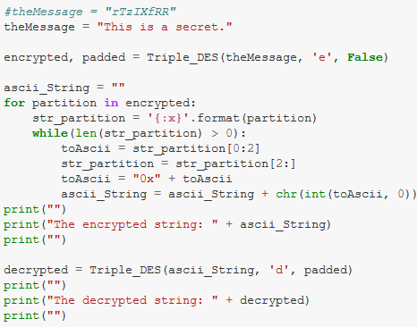
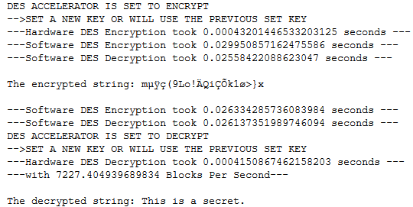
Results (cont.)

Slide 10
Limitations
ASCII strings only
There are potentially some strings that the hardware implementation cannot handle
Not traditional 3DES ordering
Is 3DES
Not secure

Slide 11
Future work
Implement AES and/or RSA in a similar way
Testing effectiveness at preventing side-channel analysis attacks

Slide 12
Team contribution
Alec - Survey paper research, finding software DES implementation, setting up hardware DES implementation, establishing software and hardware communication, report and presentation.
kalyani-Survey paper research, tested software Des implementation , finding software Des implementation for non-ASCII inputs,finding methods to convert non-ASCII to ASCII( didn’t work), report(bit contribution), presentation.

Slide 13
Team Contribution (cont.)
Meghana - Survey paper research, Finding and selecting the software DES implementation and ran the test cases. Exploring a DES implementation that works with the non-ASCII inputs, Trying the non-ASCII conversion to ASCII using bash , Project report and presentation
Rachana - Survey paper research, looked up hardware implementations, looked up information for communication between software and hardware, presentation

Slide 14
Presentation link
https://www.youtube.com/watch?v=_ooK8TsRVoY

